Slide 1
Content curation
What?
When?
Who?
How?
Notes:
WHAT IS CONTENT CURRATION
WHEN DO YOU CURATE YOUR CONTENT
HOW CAN YOU IDENTIFY RELEVANT CONTENT
WHO NEEDS YOUR CONTENT

Slide 2
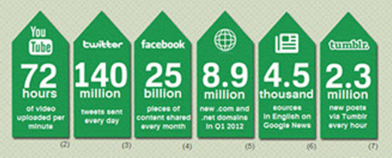
What is content curation?

Slide 3
Steps in content curation
Shifting
Sorting
Arranging into themes
Publish
=> No new content

Slide 4

When do you curate your content?
Marketing purposes
Online platform is up-to-date
Boost SEO

Slide 5
How can you identify relevant content?
Interesting
Low competition
Amount of content
New insights?
Known & Trusted sources, additional sources

Slide 6
Who needs your content?
Selling creative work
Merchants who want to dominate
Popular publishers
News aggregators
Nonprofits

Slide 7
How to curate content for yourself or your company?
Search
Quote
Use Infographics, pictures
Comments

Slide 8
Is email a good way of distributing your content?
Yes
→ various ways of distributing it succesfully
Platforms, communities

Slide 9


Distribute content

Slide 10
SMART
Specific: Specify content
Measurable: Does it meet the criteria?
Assignable: In line with company rules?
Realistic: Is there enough content?
Time-related: stay up-to-date, meet deadlines

